Slide 1
CROP YIELD PREDICTION USING MACHINE LEARNING

Slide 2
ABSTRACT
The agriculture plays a dominant role in the growth of the country’s economy. Climate and other environmental changes has become a major threat in the agriculture field. Machine learning (ML) is an essential approach for achieving practical and effective solutions for this problem. Crop Yield Prediction involves predicting yield of the crop from available historical available data like weather parameter, soil parameter and historic crop yield. This focus on predicting the yield of the crop based on the existing data by using Random Forest algorithm. Real data of Telangana were used for building the models and the models were tested with samples. The prediction will helps to the farmer to predict the yield of the crop before cultivating onto the agriculture field. To predict the crop yield in future accurately Random Forest, a most powerful and popular supervised machine learning algorithm is used.

Slide 3
INTRODUCTION
Agriculture is the backbone of every economy. In a country like India, which has ever increasing demand of food due to rising population, advances in agriculture sector are required to meet the needs. From ancient period, agriculture is considered as the main and the foremost culture practiced in India. Ancient people cultivate the crops in their own land and so they have been accommodated to their needs. Since the invention of new innovative technologies and techniques the agriculture field is slowly degrading. Due to these, abundant invention people are been concentrated on cultivating artificial products that is hybrid products where there leads to an unhealthy life. Nowadays, modern people don’t have awareness about the cultivation of the crops in a right time and at a right place. Because of these cultivating techniques the seasonal climatic conditions are also being changed against the fundamental assets like soil, water and air which lead to insecurity of food. By analyzing all these issues and problems like weather, temperature and several factors, there is no proper solution and technologies to overcome the situation faced by us. There are multiple ways to increase and improve the crop yield and the quality of the crops.

Slide 4
INTRODUCTION
Data mining also useful for predicting the crop yield production. Generally, data mining is the process of analyzing data from different perspectives and summarizing it into useful information. Data mining software is an analytical tool that allows users to analyze data from many different dimensions or angles, categorize, and summarize the relationships identified. The patterns, associations, or relationships among all this data can provide information. Information can be converted into knowledge about historical patterns and future trends. For example, summary information about crop production can help the farmers identify the crop losses and prevent it in future. Crop yield prediction is an important agricultural problem. Each and Every farmer is always tries to know, how much yield will get from his expectation. In the past, yield prediction was calculated by analyzing farmer's previous experience on a particular crop. The Agricultural yield is primarily depends on weather conditions, pests and planning of harvest operation. Accurate information about history of crop yield is an important thing for making decisions related to agricultural risk management.Therefore, this proposes an idea to predict the yield of the crop .The farmer will check the yield of the crop as per the acre ,before cultivating onto the field.

Slide 5
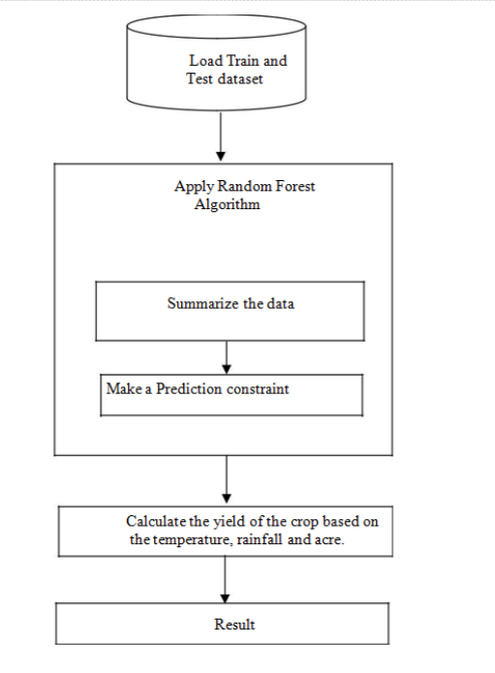
WORK FLOW

Slide 6
CONCLUSION
The Results shows that we can attain an accurate crop yield prediction using the Random Forest algorithm. Random Forest algorithm achieves a largest number of crop yield models with a lowest models. It is suitable for massive crop yield prediction in agricultural planning. This makes the farmers to take the right decision for right crop such that the agricultural sector will be developed by innovative ideas.

Slide 7
THANK YOU
-Shiva Kumar Chakali
-Sriya Pogula

